Slide 1
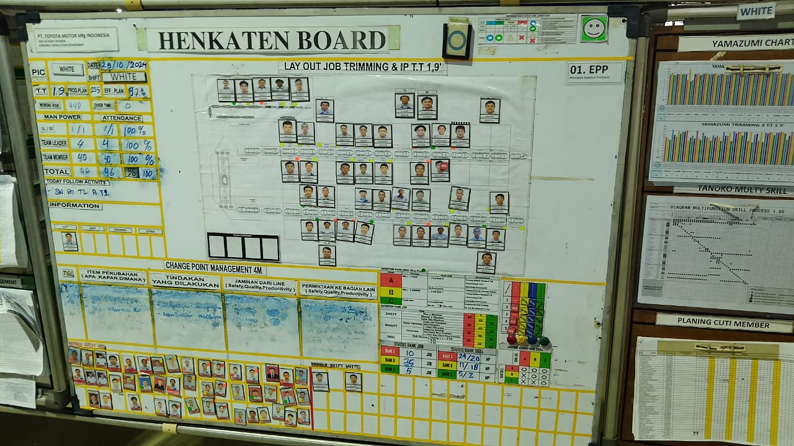
HALAMAN UTAMA / DASHBOARD
TRIMMING
DIGITAL BOARD
USERS
SETTINGS
DITAMPILKAN HALAMAN ISI
HENKATEN BOARD
HENKATEN BOARD
Foto bisa di pindah
SGA BOARD
GL MANAGEMENT BOARD
TPM CONTROL BOARD
GENTANI BOARD
DEFECT OPERATOR

Slide 2
SETTINGS
HENKATEN BOARD
Bisa diisi manual
HENKATEN BOARD
SGA BOARD
GL MANAGEMENT BOARD
TPM CONTROL BOARD
Diisi foto MP
Diisi foto MP
GENTANI BOARD
DEFECT OPERATOR
MEMBER SHIFT RED
Diisi foto MP
MEMBER SHIFT WHITE

Slide 3
SGA BOARD
HAZARD TRIMMING & IP
STRUKTUR SGA RED
STRUKTUR SGA WHITE
Di klik maka akan langsung muncul file PDF sesuai folder
ZERO ACCIDENT RED
ZERO ACCIDENT WHITE
HUMAN RED
HUMAN WHITE
KOMUNIKASI
WORKSITE.ENV
TEMUAN RANK Aa, Bb, Cc
SAFETY INFORMASI
YOKOTEN ACCIDENT
MACHINE

Slide 4
GL MANAGEMENT BOARD
SAFETY
QUALITY
PRODUCTIVITY
Tampilan Halaman
Ada gambar
COST
HUMAN RESOURCES
MAIN KPI
SUB KPI
PROCESS KPI
Jika di klik, akan muncul ini
Di klik maka akan muncul file PDF sesuai folder
-
-
2024
JAN
DES
JAN
DES

Slide 5
GENTANI BOARD
MARKING
ARM COVER
Di klik maka akan langsung muncul file PDF sesuai folder
SARUNG TANGAN 5 BENANG
APRON BODY
SARUNG TANGAN 6 BENANG
SAFETY GLOVES
SEALER GLASS
COMET 801

Slide 6
DEFECT OPERATOR
TL A
TL C
TL B
TL D
Di klik maka akan muncul
DAFTAR FORMAT MANUAL SEPERTI BERIKUT

